Slide 1



Comprehensive Network Configuration
An In-Depth Analysis of Network Infrastructure and Configurations
Presented by:
Vinh Vu,
Kunjal Mahant,
Baljinder Kaur
Date: Dec. 12, 2024

Slide 2

Comprehensive Network Configuration
An In-Depth Analysis of Network Infrastructure and Configurations
Presented by:
Vinh Vu,
Kunjal Mahant,
Baljinder Kaur
Date: Dec. 12, 2024

Slide 3
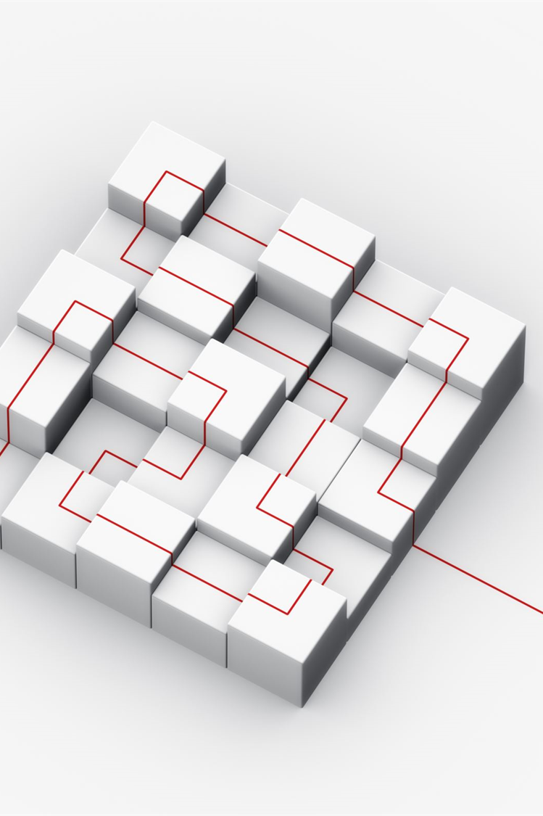
Table of Contents
Network Configuration Overview
Physical and Logical Network Layout
IP Addressing Scheme Details
Router Configurations Breakdown
Switch Configurations Overview
VLAN Assignments and Configurations
Demo

Slide 4

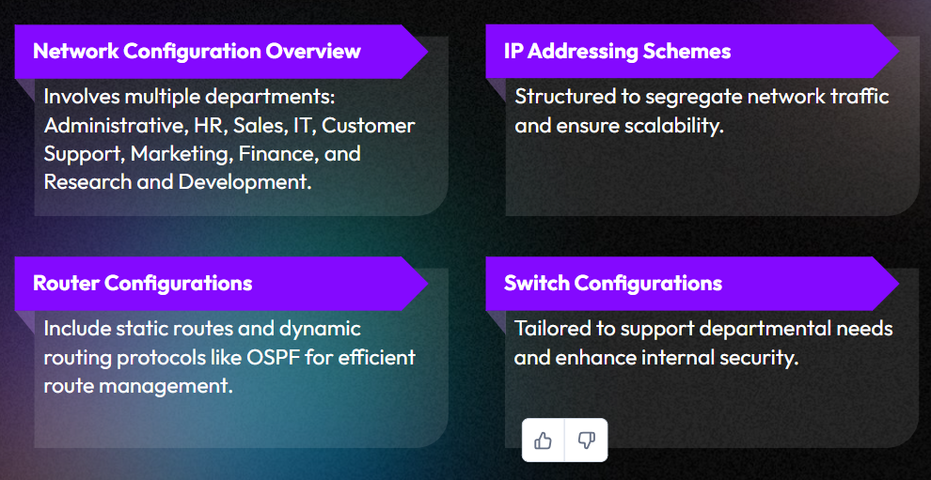


Network Configuration Overview

Slide 5
Physical and Logical Network Layout
Physical Layout
Logical Layout
Main Office: Contains one router and one switch, managing 8 computer connections in Administrative, HR, Sales, and IT departments.
Branch Office 1: Contains one router and one switch, managing 4 computer connections in Customer Support and Marketing departments.
Branch Office 2: Contains one router and one switch, managing 4 computer connections in Research and Development and Finance departments.
Main Office Network:
Administrative Department: 192.168.0.0/25
HR Department: 192.168.0.128/25
Sales Department: 192.168.1.0/25
IT Department: 192.168.1.128/25
Branch Office 1 Network:
Customer Support Department: 192.168.2.0/26
Marketing Department: 192.168.2.64/26
Branch Office 2 Network:
Finance Department: 192.168.6.0/26
R & D Department: 192.168.6.64/26

Slide 6
IP Addressing Scheme Details
Main Office Admin Department
Main Office HR Department
Subnet: 192.168.0.0/25
Router IP: 192.168.0.1
Usable IP Range: 192.168.0.2 to 192.168.0.126
Subnet: 192.168.0.128/25
Router IP: 192.168.0.129
Usable IP Range: 192.168.0.130 to 192.168.0.254
Main Office Sales Department
Main Office IT Department
Subnet: 192.168.1.0/25
Router IP: 192.168.1.1
Usable IP Range: 192.168.1.2 to 192.168.1.126
Subnet: 192.168.1.128/25
Router IP: 192.168.1.129
Usable IP Range: 192.168.1.130 to 192.168.1.254

Slide 7



Router Configurations Breakdown
Main Office Router
Branch Office 1 Router
Branch Office 2 Router
Hostname: MainOfficeRouter
FastEthernet0/0.10 - 192.168.0.1/25
FastEthernet0/0.20 - 192.168.0.129/25
FastEthernet0/0.30 - 192.168.1.1/25
FastEthernet0/0.40 - 192.168.1.129/25
Hostname: BranchOffice1Router
FastEthernet0/0.10 - 192.168.2.1/26
FastEthernet0/0.20 - 192.168.2.65/26
Serial2/0 - 30.0.0.2/8
Serial3/0 - 20.0.0.1/8
Hostname: BranchOffice2Router
FastEthernet0/0.10 - 192.168.6.1/26
FastEthernet0/0.20 - 192.168.6.65/26
Serial2/0 - 10.0.0.2/8
Serial3/0 - 30.0.0.1/8

Slide 8

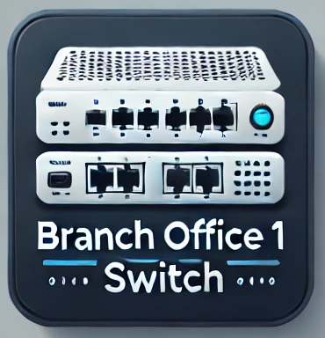

Switch Configurations Overview
Main Office Switch
Branch Office 1 Switch
Branch Office 2 Switch
Hostname: MainOfficeSwitch
VLAN 10 (Administrative Department) - Port Range: FastEthernet0/1 - 2
VLAN 20 (HR Department) - Port Range: FastEthernet0/3 - 4
VLAN 30 (Sales Department) - Port Range: FastEthernet0/5 – 6
VLAN 40 (IT Department) - Port Range: FastEthernet0/7 – 8
Hostname: BranchOffice1Switch
VLAN 10 (Customer Support Department) - Port Range: FastEthernet0/1 - 2
VLAN 20 (Marketing Department) - Port Range: FastEthernet0/3 – 4
Hostname: BranchOffice2Switch
VLAN 10 (Finance Department) - Port Range: FastEthernet0/1 - 2
VLAN 20 (Research and Development Department) - Port Range: FastEthernet0/3 - 4

Slide 9
VLAN Assignments and Configurations
Main Office
VLAN 10 (Admin Department)
VLAN 20 (HR Department)
Main Office Switch: Ports 1-2 (i.e. Fa0/1 - 0/2)
Main Office Switch: Ports 3-4 (i.e. Fa0/3 - 0/4)
VLAN 30 (Sales Department)
VLAN 40 (IT Department)
Main Office Switch: Ports 5-6 (i.e. Fa0/5 - 0/6)
Main Office Switch: Ports 7-8 (i.e. Fa0/7 - 0/8)

Slide 10
VLAN Assignments and Configurations
Branch Office 1
Branch Office 2
VLAN 10 (Finance Department)
VLAN 10 (Customer Support Dept.)
Branch Office 1 Switch: Ports 1-2 (i.e. Fa0/1 - 0/2)
Branch Office 2 Switch: Ports 1-2 (i.e. Fa0/1 - 0/2)
VLAN 20 (Marketing Department)
VLAN 20 (R & D Department)
Branch Office 1 Switch: Ports 3-4 (i.e. Fa0/3 - 0/4)
Branch Office 2 Switch: Ports 3-4 (i.e. Fa0/3 - 0/4)

Slide 11

DEMO

